Slide 1
Interpreting the retinal neural code for natural scenes: From computations to neurons
Niru Maheswaranathan, Lane T. McIntosh, Hidenori Tanaka, Satchel Grant, David B. Kastner, Joshua B. Melander, Aran Nayebi, Luke E. Brezovec, Julia H. Wang, Surya Ganguli, and Stephen A. Baccus

Slide 2
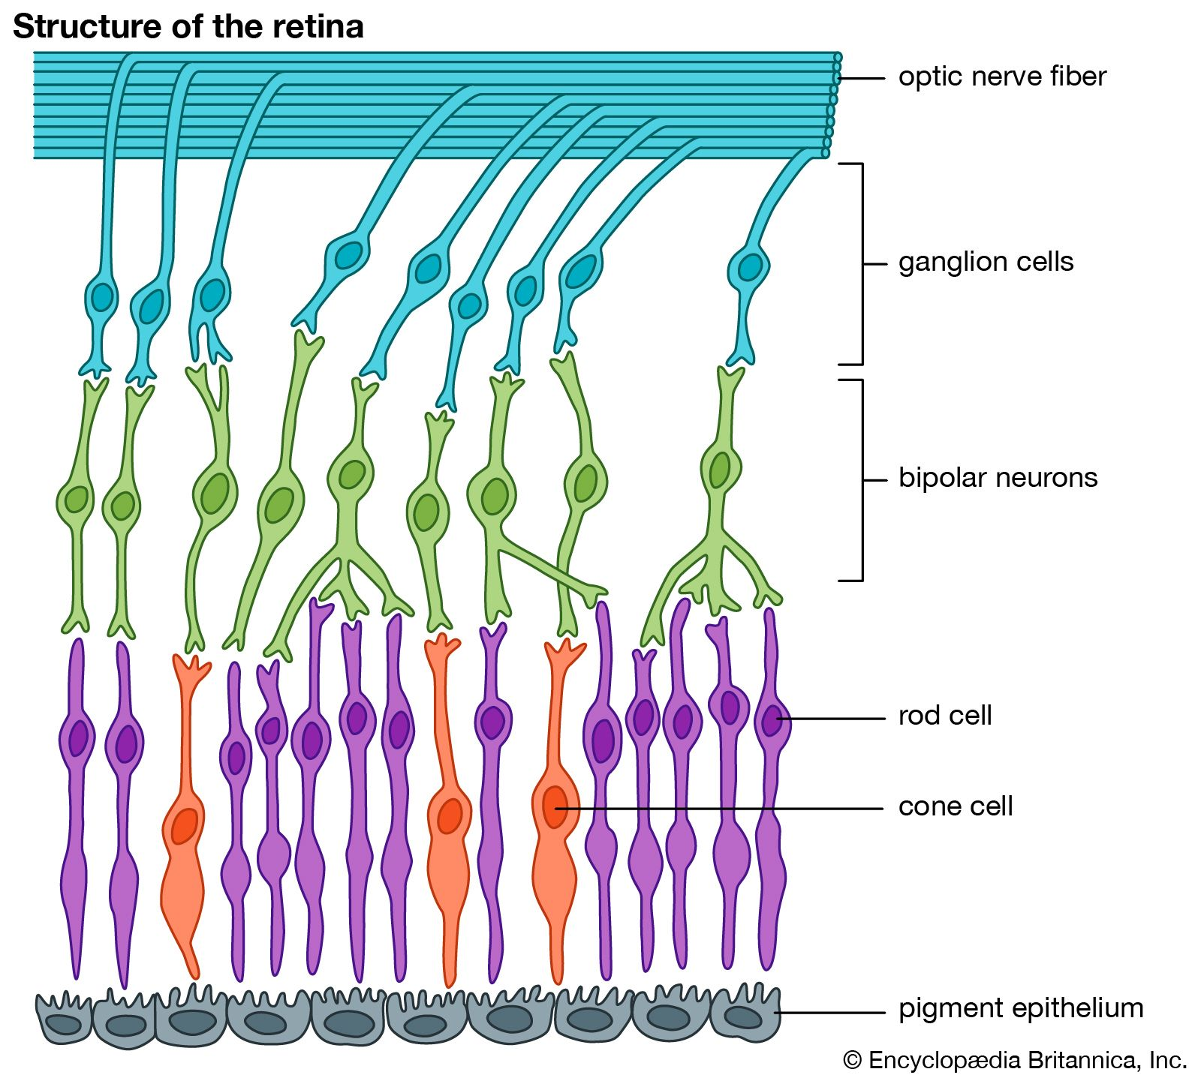

Slide 3
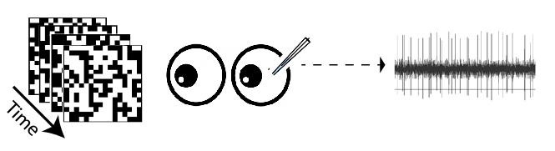


Spike-Triggered Average (STA)
ON-center Difference of Gaussian
OFF-center Difference of Gaussian

Slide 4
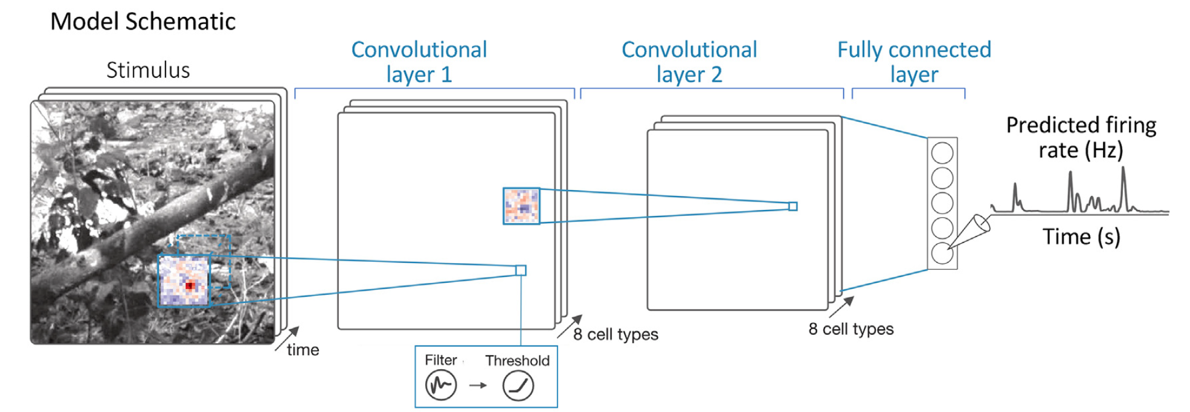

Slide 5
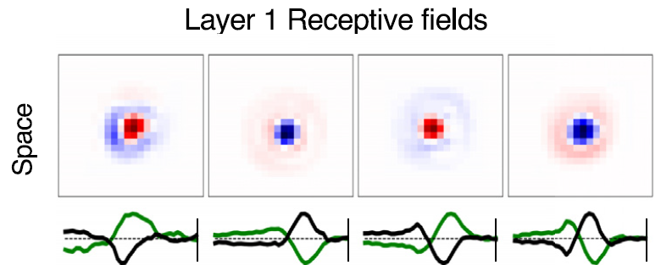
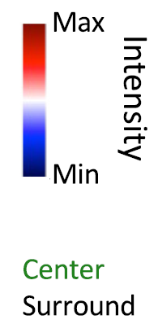

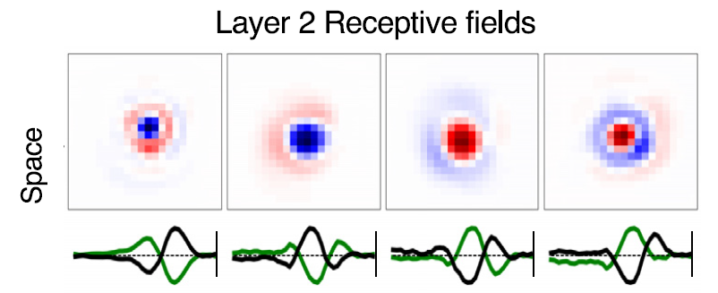

Slide 6
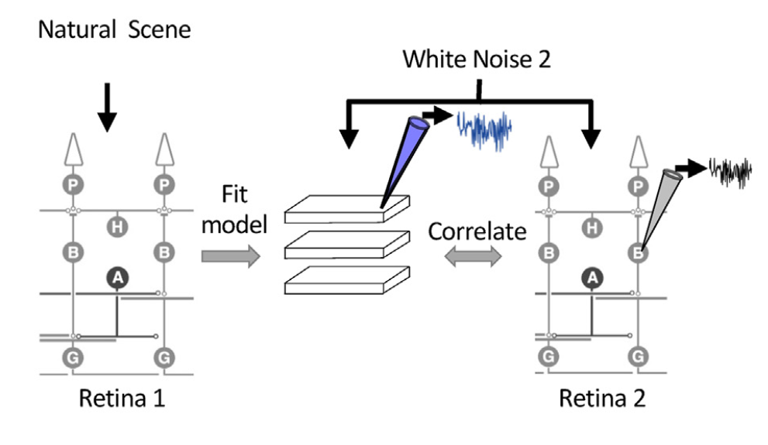
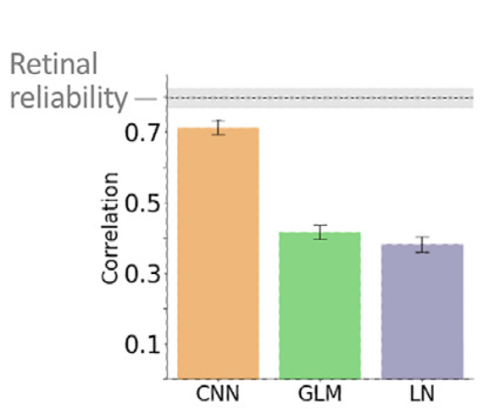

Slide 7
